Slide 1

Simulation Based Assignment
Student Name: Prudhvi Rambha
Student ID : 11613210
Email Address: Prudhvirambha@gmail.com
GitHub Link: https://github.com/prudhvirambha/cse316
Faculty Name: Oshin
UID : 21980
Course Code : CSE 316
Lovely Professional University , Punjab

Slide 2
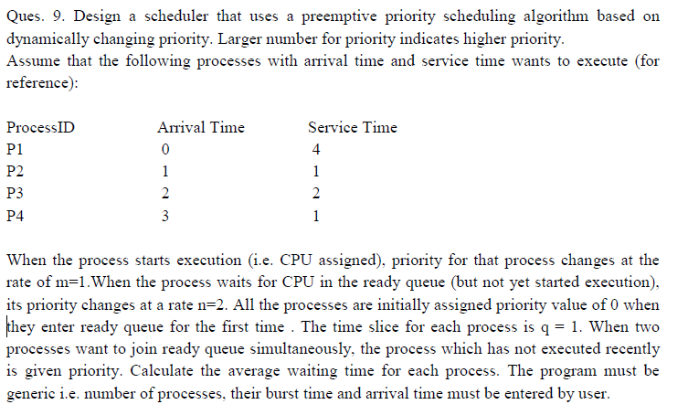
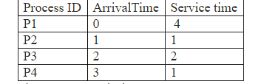
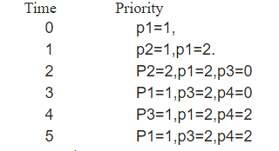
Question 1:
Description :
The Processes in the above table execute on the basis of time slice which value is 1 and also on dynamically changing priorities .
Here's how there will get executed :
The Priorities changes in this manner

Slide 3

These are completion times of the processes:
1.The process P1 finished at 8.
2.The process P2 finished at 2.
3.The process P3 finished at 7.
4.The process P4 finished at 5.
Algorithm :
P1 | P2 | P1 | P3 | P4 | P1 | P3 | P1
0 1 2 3 4 5 6 7 8
Gantt Chart :
Constraints :
Time Slice =1
Initially All priorities are =0
Priority for the running process =1
Priority for process waiting in Ready queue =2

Slide 4
Code Snippet :
#include<unistd.h>
#include<stdio.h>
int ct[40]={0},qt,qas[40]={0},c=0,st,btm[40]={0},tt, wt,at[40],bt[40],zz;
void queue1(int fin,int tm);
void queue2(int fin, int tm);
void pop(int fin);
float att, awt;
int flg=0,tm=0,ee=0,fin=0;
void pop(int fin){
qas[ee]=fin+1;
ee++;
}
void queue1(int fin,int tm){
for(int x=fin+1;x<4;x++){
if(at[x]<=tm){
qas[ee]=x+1;
ee++;}
}
}
void queue2(int fin, int tm){
for(int x=fin+1;x<4;x++){
int fl=0;
for(int y=0;y<ee;y++){
if(qas[y]==x+1){
fl++;}}
if(at[x]<=tm && fl==0 && btm[x]!=0){
qas[ee]=x+1;
ee++;}
}
}

Slide 5
main()
{
printf("\nEnter time slice:");
scanf("%d",&qt);
printf("Enter no of process");
scanf("%d",&zz);
for(int x=0;x<zz;x++){
printf("\n Process %d",x+1);
printf("\n Arrival Time=");
scanf("%d",&at[x]);
printf(" Burst Time=");
scanf("%d",&bt[x]);
btm[x]=bt[x];}
printf("\n Gantt Chart \n {%d",at[0]);
do{
if(flg==0){
st=at[0];
if(btm[0]<=qt){
tm=st+btm[0];
btm[0]=0;
queue1(fin,tm);}
else{
btm[0]=btm[0]-qt;
tm=st+qt;
queue1(fin,tm);
pop(fin);}
}
else{
fin=qas[0]-1;
st=tm;

Slide 6
for(int x=0;x<ee && ee!=1;x++){
qas[x]=qas[x+1];}
ee--;
if(btm[fin]<=qt){
tm=st+btm[fin];
btm[fin]=0;
queue2(fin, tm);}
else{
btm[fin]=btm[fin]-qt;
tm=st+qt;
queue2(fin, tm);
pop(fin);}
}
if(btm[fin]==0){
ct[fin]=tm;
}
flg++;
printf("}->P%d<-{%d",fin+1,tm);
}while(ee!=0);
printf("} ");
printf("\n\nProcess \t Arrival Time\t Burst Time \t Completition Time\t Turn Around Time\t Waiting Time\n");
for(int x=0;x<zz;x++){
tt=ct[x]-at[x];
wt=tt-bt[x];
printf("P%d\t\t %d\t\t %d\t\t %d\t\t\t %d\t\t\t %d\n",x+1,at[x],bt[x],ct[x],tt,wt);
awt=awt+wt;
att=att+tt;
}
printf("\nAverage Turn Around Time: %f\nAverage Waiting Time: %f",att/4,awt/4);
}

Slide 7
Boundary Conditions :
Time Slice Should be always 1 as it acts similarly as Round Robin alogorithm
Test Case :
This is the given default test case for reference.
Have you made minimum 5 revisions of solution on GitHub? Yes
GitHub Link: https://github.com/prudhvirambha/cse316

Slide 8
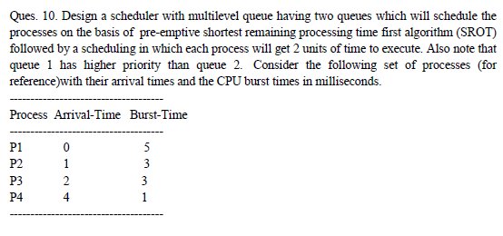
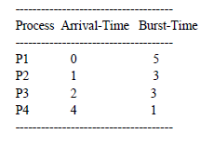
Question 2:
Description :
The Processes in the above table execute on the basis of time slice which value is 1 and also depends on priority of two queues.
Using Shortest remaining time first.
The Priorities of first queue is more than the priority of 2nd queue

Slide 9
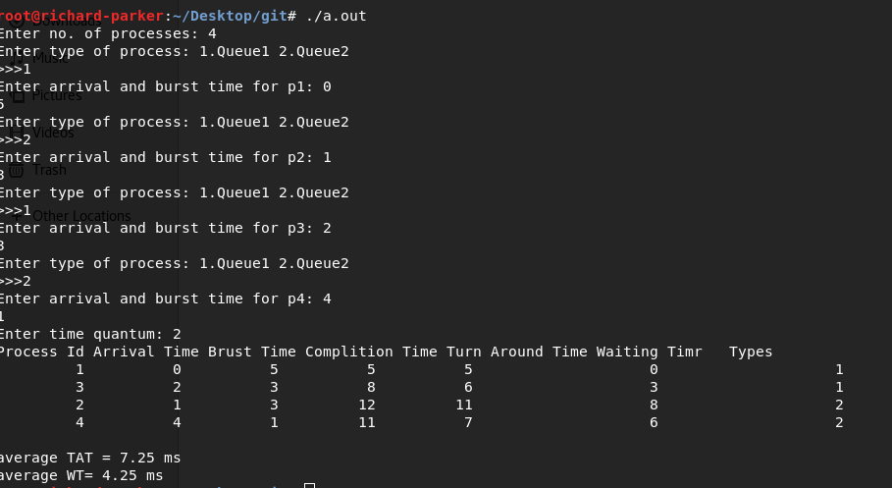
These are completion times of the processes:
1.The process P1 finished at 5.
2.The process P2 finished at 8.
3.The process P3 finished at 12.
4.The process P4 finished at 11.
If P1&P3 are in queue1 and p2&p4 are in queue2
Constraints :
Time Slice =2
Priority of first queue is more than priority of queue2

Slide 10
Code Snippet :
#include<stdio.h>
#include<stdlib.h>
#include<strings.h>
#define size 40
#define info 42567
int time;
typedef struct process
{
int pid,AT,BT,CT,TAT,WT,RT,type;
}process;
typedef struct queue{
int q[size];
int f,r;
}queue;
void output(process p[],int n)
{
int i;
printf("Process Id Arrival Time Brust Time Complition Time Turn Around Time Waiting Timr Types\n");
for(i=0;i<n;i++)
{
printf("%10d %10d %10d %10d %10d %20d %20d\n",p[i].pid,p[i].AT,p[i].BT,p[i].CT,p[i].TAT,p[i].WT,p[i].type);
}
printf("\n");
}
void ins(queue *t,int ele)
{
t->r++;
t->q[t->r] = ele;
}

Slide 11
Code Snippet :
int qf(queue *t)
{
return t->q[t->f];
}
int del1(queue *t){
int i=t->f;
int z=t->q[t->f];
while(i < t->r){
t->q[i] = t->q[i+1];
i++;
}
t->r--;
return z;
}
void sort(process p[],int n)
{
int i,j;
process val;
for(i=0;i<n-1;i++)
{
val = p[i+1];
for(j=i;j>=0;j--)
if(val.type<p[j].type)
p[j+1] = p[j];
else
break;
p[j+1] = val;
}
}

Slide 12
Code Snippet :
int tnt(process p[],int n,int time)
{
int i = pop(p,n,time);
p[i].RT--;
if(p[i].RT == 0)
{
p[i].CT = time+1;
p[i].TAT = p[i].CT - p[i].AT;
p[i].WT = p[i].TAT - p[i].BT;
}
return p[i].pid;
}
float avgTAT(process p[],int n)
{
int i;
float avg=0;
for(i=0;i<n;i++)
avg += p[i].TAT;
avg = avg / n;
return avg;
}
float avgWT(process p[],int n)
{
int i;
float avg=0;
for(i=0;i<n;i++)
avg += p[i].WT;
avg = avg / n;
return avg;
}

Slide 13
Code Snippet :
void mqu(process p[],int n,int tq,int chart[])
{
int t,i,j,T=0,hp;
int cur_pid;
queue x;
x.f = 0;
x.r = -1;
for(i=0;i<n;i++)
T += p[i].BT;
atsort(p,n);
sort(p,n);
for(t=0;t<T;t++)
{
for(i=0;i<n;i++)
if(p[i].type == 2&&p[i].AT==t)
ins(&x,p[i].pid);
for(i=0;i<n;i++int tnt(process p[],int n,int time)
{
int i = pop(p,n,time);
p[i].RT--;
if(p[i].RT == 0)
{
p[i].CT = time+1;
p[i].TAT = p[i].CT - p[i].AT;
p[i].WT = p[i].TAT - p[i].BT;
}
return p[i].pid;
}
float avgTAT(process p[],int n)
{
int i;
float avg=0;
for(i=0;i<n;i++)
avg += p[i].TAT;
avg = avg / n;
return avg;
}
float avgWT(process p[],int n)
{
int i;
float avg=0;
for(i=0;i<n;i++)
avg += p[i].WT;
avg = avg / n;
return avg;
}
)
if(p[i].AT <= t&&p[i].RT != 0)
break;
if(i==n)
break;

Slide 14
Code Snippet :
int rr(process p[],queue *t,int tq,int n,int time)
{
int i,runTime,cp;
cp = qf(t);
for(i=0;i<n;i++)
if(p[i].pid == cp)
break;
p[i].RT--;
runTime = p[i].BT-p[i].RT;
if(runTime%tq == 0 && p[i].RT != 0)
{
del1(t);
ins(t,cp);
}
if(p[i].RT == 0)
{
p[i].CT = time+1;
p[i].TAT = p[i].CT - p[i].AT;
p[i].WT = p[i].TAT - p[i].BT;
del1(t);
}
return p[i].pid;
}

Slide 15
Code Snippet :
int main()
{
int i,n,q,chart[size];
process p[size];
float avg_tat,avg_wt;
printf("Enter no. of processes: ");
scanf("%d",&n);
for(i=0;i<n;i++)
{
printf("Enter type of process: 1.Queue1 2.Queue2 \n>>>");
scanf("%d",&p[i].type);
printf("Enter arrival and burst time for p%d: ",i+1);
scanf("%d%d",&p[i].AT,&p[i].BT);
p[i].pid = i+1;
p[i].RT = p[i].BT;
}
printf("Enter time quantum: ");
scanf("%d",&q);
mqu(p,n,q,chart);
output(p,n);
avg_tat = avgTAT(p,n);
printf("average TAT = %.2f ms\n",avg_tat);
avg_wt = avgWT(p,n);
printf("average WT= %.2f ms\n",avg_wt);
}

Slide 16
Boundary Conditions :
The Priority of first queue should be greater than the second queue and it should be SROT
Test Case :
This is the given default test case for reference.
Have you made minimum 5 revisions of solution on GitHub? Yes
GitHub Link: https://github.com/prudhvirambha/cse316

